Slide 1
Telecom Systems Laboratory TLEN 5460 Site-to-site IPSec VPNs
Jose Santos
Interdisciplinary Telecommunications Program

Slide 2
Intro
Enterprise WAN needs
Point to point technologies
Point to multipoint technologies
Pay per use/ pay per node
Need for leased line vs. transferring data over the Internet. Flexibility!
Broadband access vs. legacy/carrier technologies
(compare T1 vs MOE vs DSL vs Cable)
How can we have a private network service over a public network

Slide 3
Data encryption
Security by obscurity. As easy as preventing someone using wireshark to gain access to our information.
Mix data with a key, transmit mixed data, use key at receiver to obtain original data
Encryption algorithms: DES, 3DES, AES, RSA, RC4.
Symmetric key vs. Asymmetric key
Symmetric are faster and easier to implement in HW.
Simple?

Slide 4
Data encryption
The problem is how to distribute keys.
Encryption on its own is not enough, you need to ensure that you are exchanging information with the appropriate peer (Authentication)
Also you need to ensure that packets were not modified on their way to a particular destination (Data integrity)
Keys must change over time (Replay)

Slide 5
Standard Encapsulation
Layer 4
TCP
Telnet
Layer 3
SIP
DIP
Prot ID (TCP)
Data
SA
DA
Data
Layer 2
Prot ID (IP)

Slide 6
VPN Connection Modes
Transport (end-to-end)
Layer 4
TCP
Telnet
+ Encryption Key
Crypto Data
VPN HDR
Crypto Data
VPN TRL
SIP
DIP
Prot ID (VPN)
VPN Data
Layer 3

Slide 7
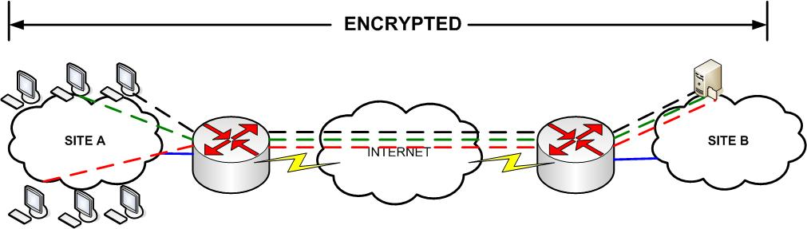
Transport Mode

Slide 8
VPN Connection Modes
Transport Mode
IP headers not encrypted (why?)
End-to-end is not scalable
Private IP addressing

Slide 9
VPN Connection Modes
Tunnel (site-to-site)
Layer 3/4
SIP
DIP
Prot ID (TCP)
TCP
Telnet
+ KEY
Crypto Data
VPN HDR
Crypto Data
VPN TRL
SIPGW
DIPGW
Prot ID (VPN)
VPN Data

Slide 10
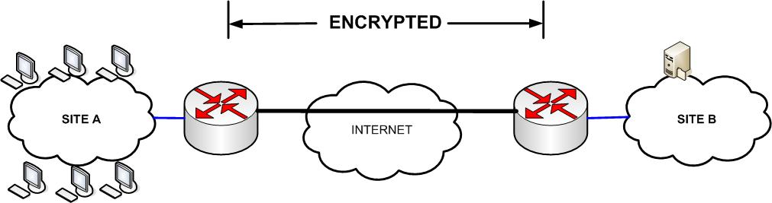
Tunnel Mode

Slide 11
Tunnel Mode
Use specialized gateway to encrypt data for multiple devices at the time
Or encrypt data for particular applications that run on such devices
Private IP space support, public IP’s only needed on GW

Slide 12
VPN types
Site-to-Site
Remote Access
Firewall
User to user

Slide 13
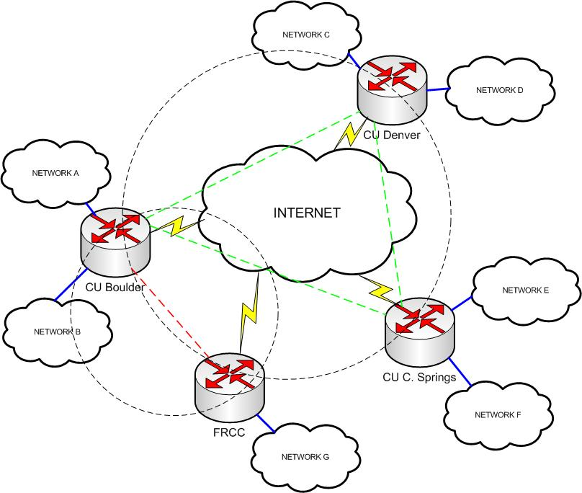

Slide 14
IPSec terms
ISAKMP (UDP 500): Internet Security Association & Key Management Protocol
Authenticates peers
Generates keys (Diffie-Hellman) to protect exchange of data kays
SA Exchange: type and strength of encryption + lifetime
ESP (IP 51): Encapsulating Security Protocol
Encryption and data integrity
AH (IP 50): Authentication Header
Data integrity
Transform Set (TS)
Defines how data traffic should be protected (security protocols/algorithms, etc)

Slide 15
IP Sec Session Steps
Select traffic that should be encrypted (ACLs)
IKE Phase 1 (IKE SA)
IKE Phase 2 (IPSec SA)
IPSec tunnel transmission
Terminate tunnel

Slide 16
IP Sec Session Steps
Select traffic that should be encrypted (ACLs)
Between 2 locations you may encrypt some traffic and some not
IKE Phase 1 (IKE SA)
Identification of each crypto peer
Pre-shared keys, Public Key (via certificate authority)
Encryption algorithm to authenticate peers (DES/RSA)
Message authentication codes (hash: MD5/SHA)
Diffie-hellman: Create a shared secret key that only peers know. Key is never exchanged on the wire.
Agree on common key, mix with private key and exchange results
Mix private with received mix (Complicated?).. Try it with colors!!
NAT transversal

Slide 17
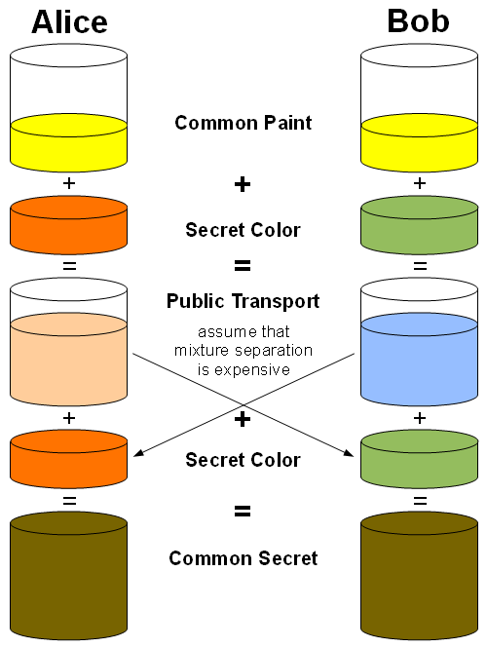
Diffie Hellman
SOURCE: https://community.emc.com/people/peterg./blog/2014/08/27/diffie-hellman

Slide 18
Diffie Hellman
https://www.youtube.com/watch?v=YEBfamv-_do (2:20 time mark)

Slide 19
IP Sec Session Steps
IKE Phase 2 (IPSec SA)
Bi-directional agreement of IPSec parameters (TS)
Encryption algorithm selection (for data per SA)
Hashed Message Authentication Codes (HMAC)
Lifetime and Mode (tunnel/transport)
IPSec tunnel transmission
2 SA’s per tunnel one of each direction
Terminate tunnel
Timeout, packet volume reached

Slide 20
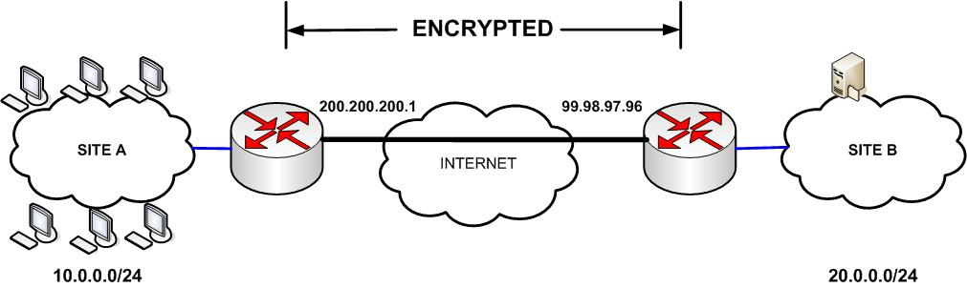
IPSec Example
LA
NY

Slide 21
Determine Interesting traffic
LA
access-list 101 permit ip 10.0.0.0 0.0.0.255 20.0.0.0 0.0.0.255
NY
access-list 101 permit ip 20.0.0.0 0.0.0.255 10.0.0.0 0.0.0.255
don’t forget to enable isakmp: crypto isakmp enable

Slide 22
Phase 1
LA
crypto isakmp policy 1
authentication pre-shared
hash md5
encryption des
group 2 //D-H
lifetime seconds
crypto isakmp key lab123 address 99.98.97.96 255.255.255.255
NY
crypto isakmp policy 1
authentication pre-shared
hash md5
encryption des
group 2
lifetime seconds
crypto isakmp key lab123 address 200.200.200.1 255.255.255.255
show crypto isakmp policy

Slide 23
Phase 2
LA
crypto ipsec transform-set my_tset esp-des esp-md5-hmac
crypto map VPN2NY 10 ipsec-isakmp
set peer 99.98.97.96
match address 101
set transform-set my_tset
set security-association lifetime seconds
NY help me!
show crypto map

Slide 24
Apply VPN service config
LA
interface serial 0/0
ip address 200.200.200.1
crypto map VPN2NY
Don’t forget your routing table!
ip route 20.0.0.0 255.255.255.0 99.98.97.96
Don’t forget to open IPsec ports on your ACL’s!
ahp 50
esp 51
udp 500
NY
interface serial 3/0
ip address 99.98.97.96
crypto map VPN2LA
ip route 10.0.0.0 255.255.255.0 200.200.200.1
show crypto ipsec sa

Slide 25
Preparing for lab
Review commands needed to support NAT with IPSec
Consider scenarios where you encrypt certain services (not all traffic)
Create more than one isakmp policy and transform sets.
Troubleshoot tunnels when keys/policies/TS do not match (debug commands)

Slide 26
IPSec performance considerations
MTU: We are adding more headers!!!
Fragmentation
Reassembly at receiver + check integrity + decryption + routing = delay
As client: Path MTU discovery
As provider: extended MTU services

Slide 27
Reference materials
IPSec intro reading: http://www.cisco.com/application/pdf/en/us/guest/netsol/ns130/c649/ccmigration_09186a0080685ce6.pdf
IPSec parameters http://www.cisco.com/univercd/cc/td/doc/product/software/ios120/12cgcr/secur_c/scprt4/scipsec.htm
IKE parameters http://www.cisco.com/univercd/cc/td/doc/product/software/ios120/12cgcr/secur_c/scprt4/scike.htm#24204
Configuration examples: (look for IP sec on Router to Router) http://www.cisco.com/en/US/tech/tk583/tk372/tech_configuration_examples_list.html

